Slide 1
BLG223E Data Structures
2022 – 2023 FALL TERM

Slide 2
RESOURCES and ENVIRONMENT
Data Structures and Algorithms in C++, 2nd Ed., Michael T. Goodrich, Roberto Tamassia, David Mount, Wiley and Sons.
Toolchain: g++ and gdb
Github repository
Docker container
Visual studio code
Build/Launch definitions for VSCode

Slide 3
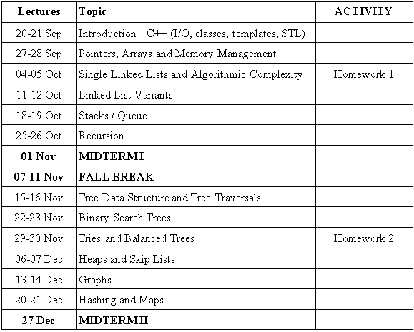
SCHEDULE

Slide 4
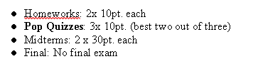
GRADING

Slide 5
ACADEMIC HONESTY
In your coding homeworks, following situations violate academic honesty:
Copy paste code from your friend’s homework
Copy paste code from internet or another source
Logical copy paste (code or logic) from your friend’s homework
Logical copy paste (code or logic) from internet or another source
following are dangerous:
Publish your solution on internet or share it with a friend
Discuss solutions over real code
Examine a solution and code at the same time
following are allowed:
Verbally discuss possible solutions with your friend (discussing over real code is dangerous)
Examine and research possible solutions on internet and other sources
To be on the safe side on plag checks do not examine any code while you are coding !!!

Slide 6
CONTENTS
1. Introduction
2. Linked Lists
3. Recursion
4.Stacks and Queues
5. Trees
6. Heaps
7. Balanced Trees
8. Maps and Hashing

Slide 7
INTRODUCTION
What is Computer Engineering and Data Structures?
C++ review
Arrays and Dynamic Memory Management
Classes and Data Abstraction

Slide 8
Software Engineering
Programming
Language
CPU
Applications
Binary Simple Operations
Advanced Operations: Functions
Loops
Conditionals
DESIGN
Needs:
Fast,
LessMemory,
Flexible
Reliable
…
Memory
Variables:
Integer, String, Class
Collections:
Array, List, Stack, Queue Tree, Heap, Hash Table
Binary Data Storage, Addresses and Bits
100111000
000101000
100001000
101110001
Address
Encoding
Identifier
Value
Data Structures

Slide 9
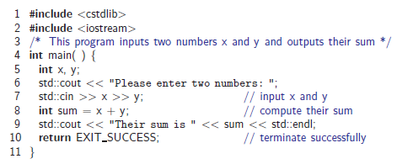
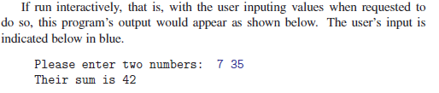
C++ Primer

Slide 10
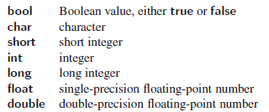
C++ Primer
Fundamental Types

Slide 11
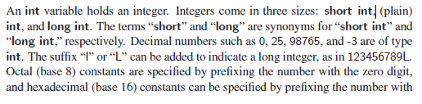
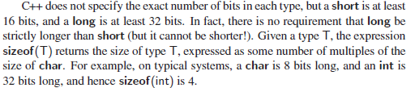
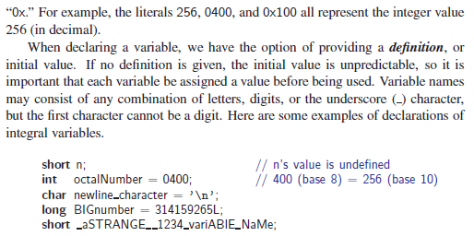
C++ Primer
Integers and Encoding

Slide 12
Pointers
Organization of computer memory
Concept of a pointer
Pointer types: var* and var&
Pointer operators, referencing and dereferencing: * and &
Pointer initialization
Pointer assignment
Pointer arithmetic

Slide 13
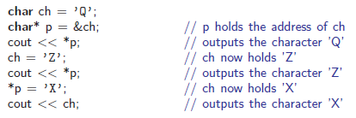
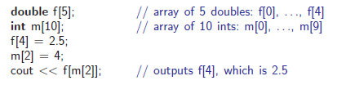
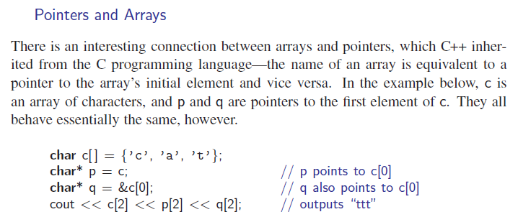
C++ Primer
Pointers
Arrays

Slide 14
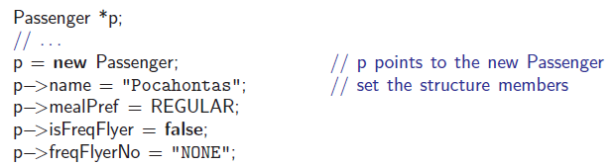
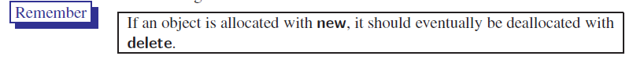
C++ Primer

Slide 15
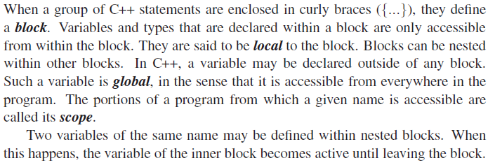
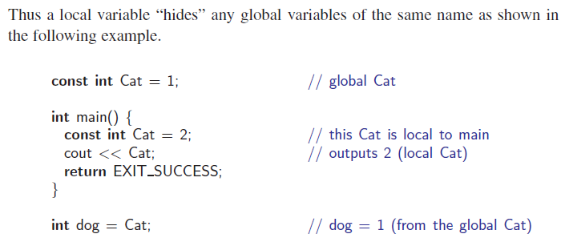
C++ Primer
Local and Global Scopes

Slide 16
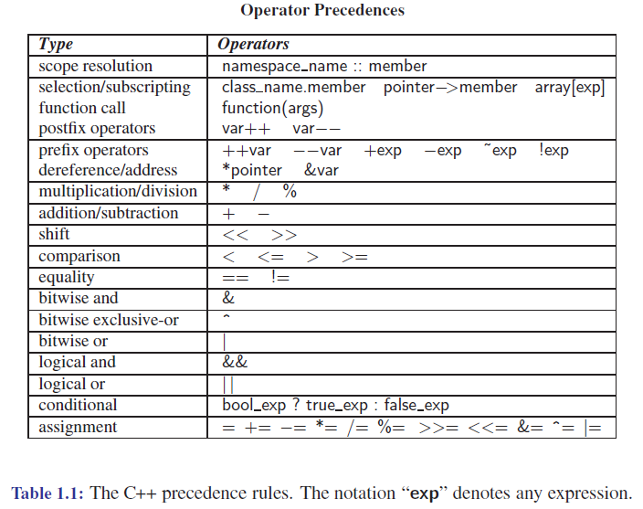
C++ Primer

Slide 17
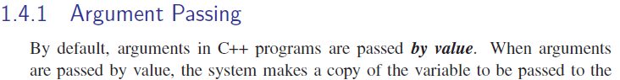
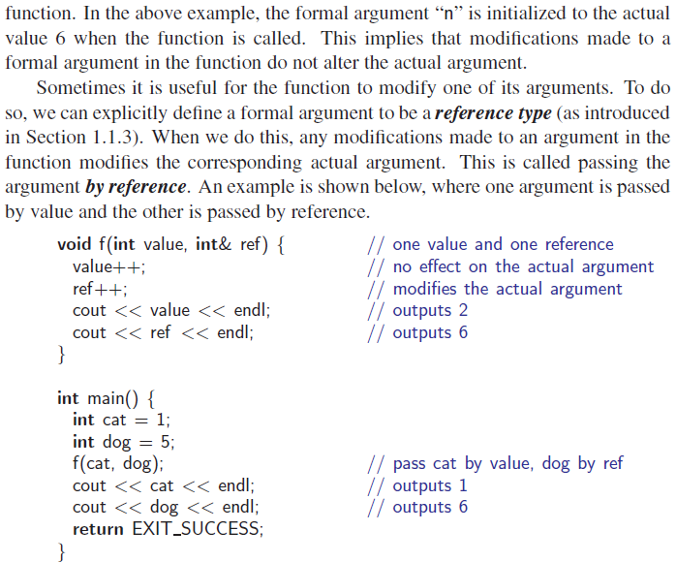
C++ Primer

Slide 18
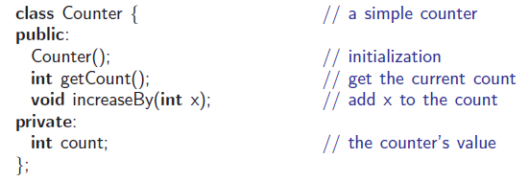
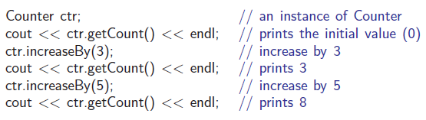
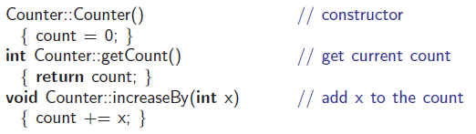
C++ Primer

Slide 19
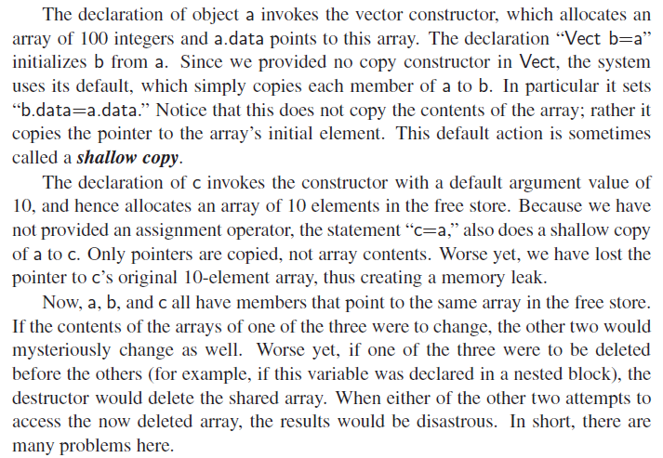
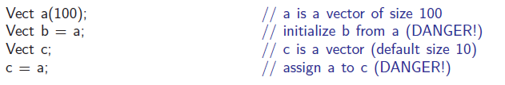
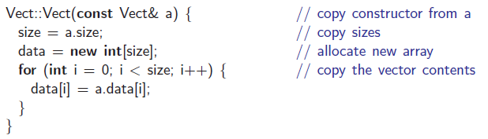
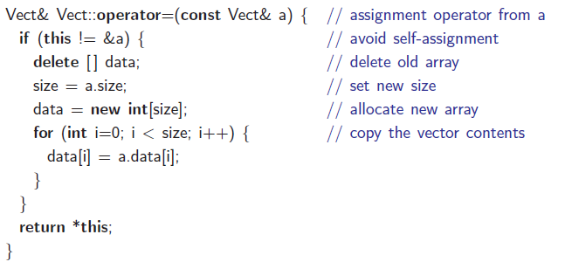
C++ Primer
Classes and Memory Allocation

Slide 20
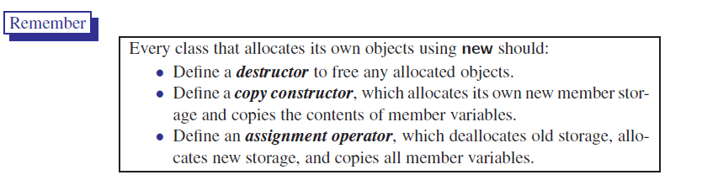
C++ Primer

Slide 21
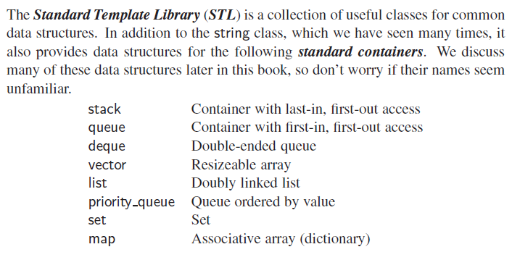
C++ Primer

Slide 22
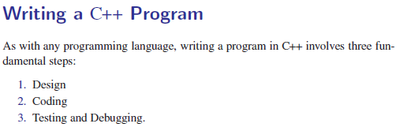
C++ Primer

Slide 23
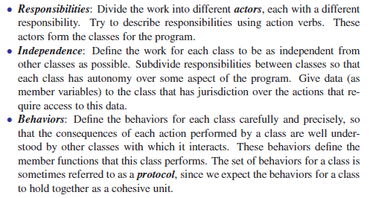
C++ Primer

Slide 24
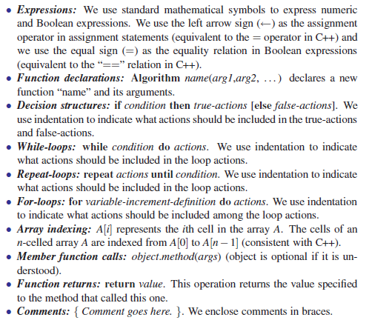
C++ Primer
Pseudo-Code

Slide 25
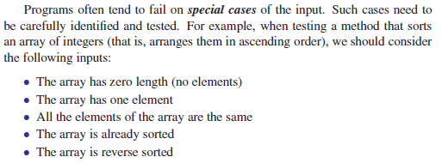
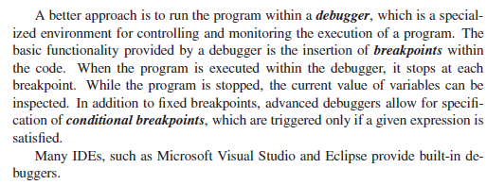
C++ Primer
Testing and Debugging

Slide 26
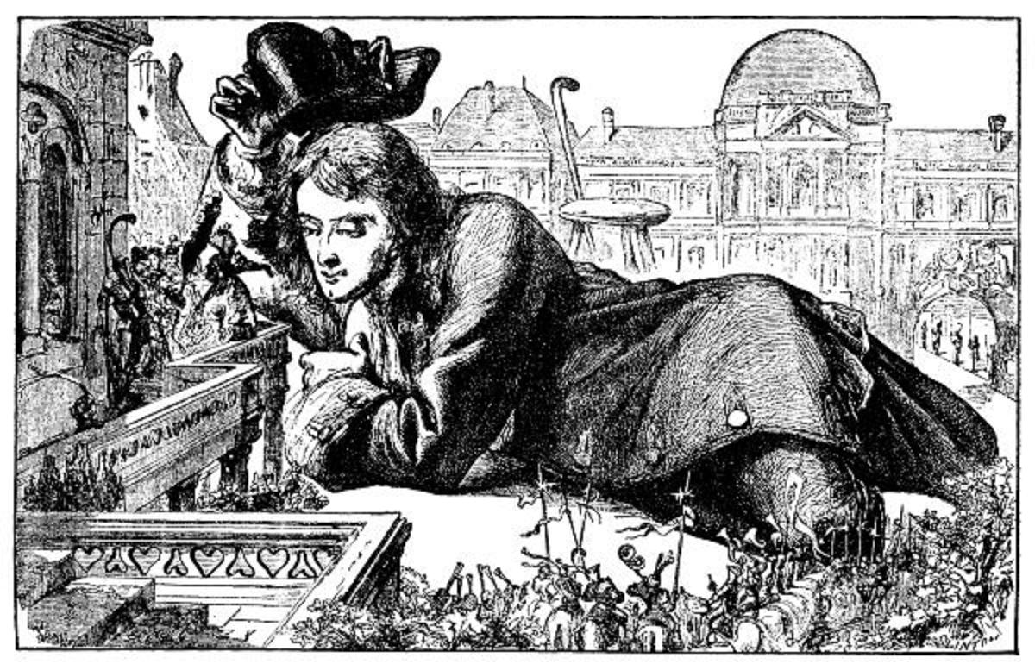
Complexity classes and Big-O notation

Slide 27
Complexity classes and Big-O notation
Measuring performance by time and size
Measurement relative to input length and counting techniques
Best, worst and average time complexity
Growth of a function, asymptotic complexity and complexity classes
Measuring time in C++

Slide 28
Complexity classes and Big-O notation
Measuring performance by time and size
Measurement relative to input length and counting techniques
Best, worst and average time complexity
Growth of a function, asymptotic complexity and complexity classes
Measuring time in C++

Slide 29
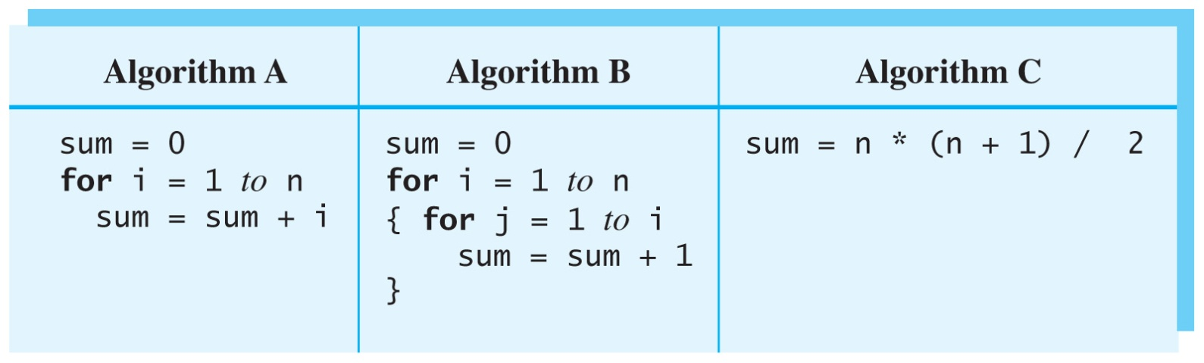
Measuring Time Complexity
How many operations will each of the following three algorithms take as a function of n ?
Count variable assignments, additions, multiplications, divisions.

Slide 30
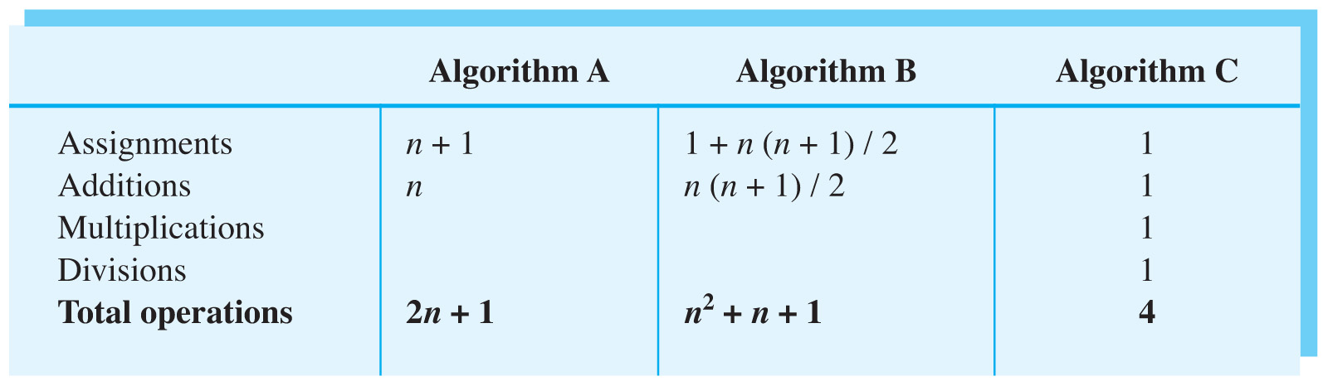
Measuring Time Complexity
The number of operations required by the three algorithms:

Slide 31
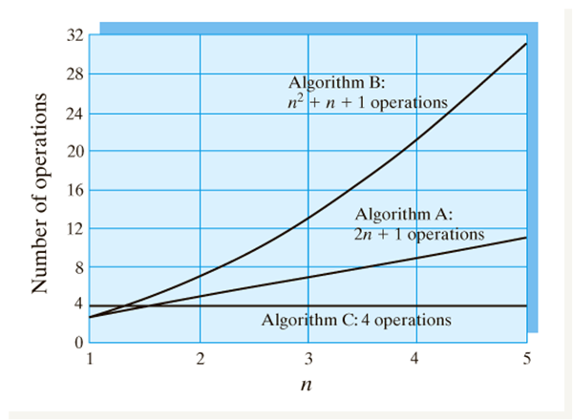
Measuring Time Complexity
The number of operations required by the three algorithms plotted as a function of n.

Slide 32
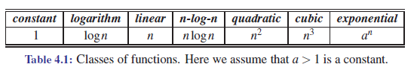
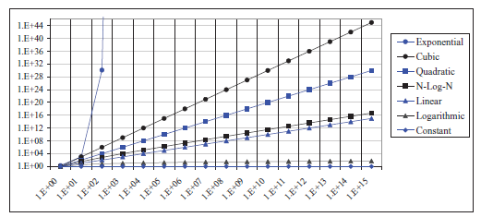

Slide 33
Complexity Classes
Constant | O(1)
Logarithmic | O(log N)
Linear | O(N)
Linearithmic | O(N logN)
Quadratic | O(N²)
Cubic | O(N³)
Polynomial | O(Nª)
Exponential | O(a^{N})
Factorial | O(N!)

Slide 34
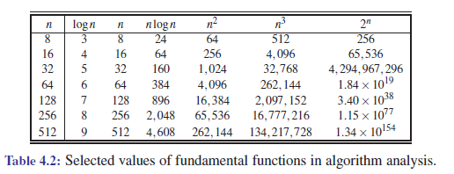

Slide 35
Running-time Examples
N | Constant O(1) | Logarithmic O(logN) | Linear O(N) | Quadratic O(N²)
1000 | 10 ns | 100 ns | 10 μs | 10 ms
1 million | 10 ns | 200 ns | 10 ms | 3 hours
1 billion | 10 ns | 300 ns | 10 sec | 300 years
1 second = 10³ mili sec = 10⁶ micro sec = 10⁹ nano sec

Slide 36
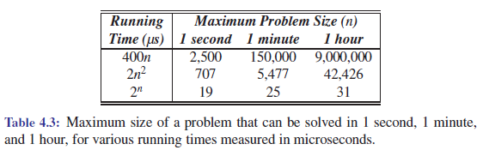
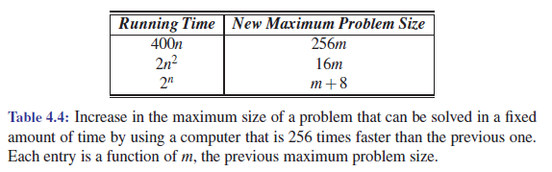

Slide 37
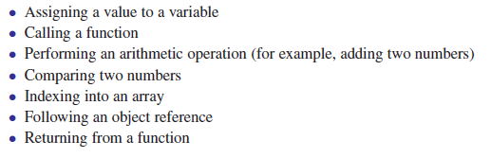
Primitive Operations

Slide 38
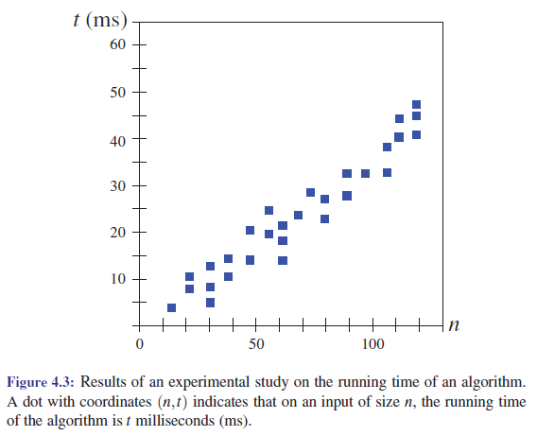

Slide 39
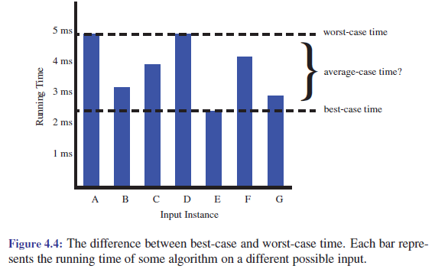

Slide 40
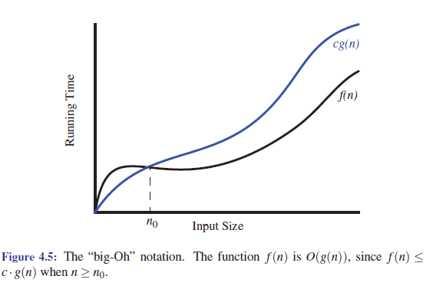

Slide 41
Types of Complexity Metrics
Notation | Pronounciation | T(N) | Meaning
O(N) | Big-O | T(N) ≤ c.f(N) | Upper bound
Ω(N) | Big-Omega | T(N) ≥ c.f(N) | Lower bound
Θ(N) | Big-Teta | T(N) = c.f(N) | Exact equal
Let T(N) be the algorithm running time.
There exists some constant c such that c.f(N) bounds T(N)
T(N) = O( f(N) ) where

Slide 42
Examples of T(N) and O( f(N) )
Running time T(N) | Asymptotic Complexity O( f(N) )
4 N log N | O(N log N)
7N² log N + 5N² + N | O(N² log N)
10 N³ + N² + 40N + 800 | O(N³)
2^{N} + 1000 N | O(2^{N})

Slide 43
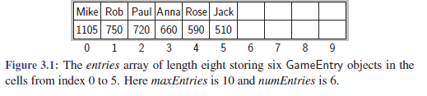
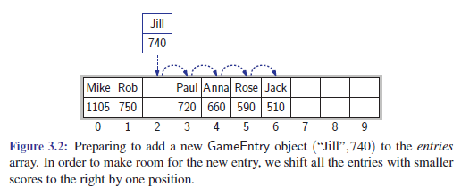
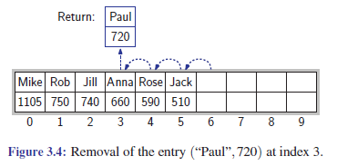
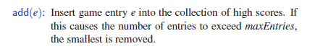
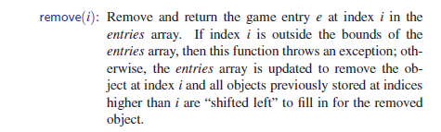

Slide 44


Storing Game Entries in an Array

Slide 45


A Class for High Scores

Slide 46

A Class for High Scores

Slide 47

A Class for High Scores

Slide 48

Sorting an Array

Slide 49


Sorting an Array

Slide 50


Slide 51
LINKED LISTS
3.1. Single Linked Lists (Ch. 3.2)
3.2. Double Linked Lists and Multilists (Ch. 3.3)
3.3. Sentinels and Circular Linked Lists (Ch. 3.4)
3.4. STL Lists and Related Data Structures (Ch. 6.1 Ch. 6.2)

Slide 52

Single Linked Lists

Slide 53
Single Linked Lists
Incapabilities of arrays, need for linked list
Linked list node structure
Linked list ADT w head and tail
Addition to empty, head, tail and in between
Traversal in a linked list
Removal from empty, head, tail and in between

Slide 54




Slide 55


Slide 56



Slide 57



Slide 58



Implementing a Generic Singly Linked List

Slide 59




Slide 60


Slide 61



Slide 62



Slide 63






Slide 64





Slide 65

Maintaining a Playlist for a Digital Audio Player

Slide 67

Reversing a Linked List

Slide 68
Double Linked Lists and Multilists
Double Linked list node structure
Linked list ADT w head and tail
Addition to empty, head, tail and in between
Removal from empty, head, tail and in between
Multilist concept
Rebuilding vs addition and removal

Slide 69
Sentinels and Circular Linked Lists
Concept of a sentinel
Circular linked list structure
Addition and removal to circular linked list

Slide 70
STACKS AND QUEUES
2.1. Stack data structure (Ch. 5.1)
2.2. Queue data struture (Ch. 5.2)
2.3. STL stack, queue and deque (Ch. 5.1.2 Ch. 5.2.2 Ch. 5.3.2 )

Slide 71
Stack Data Structure
Concept of a Stack
How is a Stack useful?
Properties and methods of a Stack
Stack ADT - Detour: C++ template methods and classes
Stack exceptions

Slide 72


Slide 73



Slide 74


Slide 75



Slide 76



A Simple Array-Based Stack Implementation

Slide 77


Slide 78


Slide 79


Slide 80



Implementing a Stack with a Generic Linked List

Slide 81

Reversing a Vector Using a Stack

Slide 82


Parentheses Matching

Slide 83



Queues

Slide 84


The STL Queue

Slide 85



A Simple Array-Based Implementation

Slide 86



Slide 87



Implementing a Queue with a Circularly Linked List

Slide 88


Double-Ended Queues

Slide 89




Slide 90

The STL Deque

Slide 92

Queue Data Structure

Slide 93
Queue Data Structure
Concept of a Queue
How is a Queue useful?
Properties and methods of a Queue
Queue ADT
Queue exceptions
Cyclic Queue
Double ended queues

Slide 94

STL stack and queue

Slide 95
STL stack and queue
Introduction to STL (and templating in C++)
STL Stack
STL Queue
STL Double-Ended Queue
STL Priority Queue
Example applications
Parantheses matching
Expression evaluation

Slide 96
RECURSION
4.1. Function calls (Ch. 1.4)
4.2. Recursion (Ch. 3.5)
4.3. Tail recursion (Ch. 3.5)
4.4. Towers of hanoi

Slide 97

Function Calls

Slide 98
Function Calls
Function Call Operations and System Stack
Pass by reference and pass by value revisited

Slide 99
Recursion
Mathematical definition
Recursion in C++
Tracing recursion
Recursive data structures

Slide 100

Tail Recursion

Slide 101
Tail Recursion
Recursion vs Iteration
Recursion and Stacks
Tail recursion
Binary recursion

Slide 102

Recursion

Slide 103





Recursion
Complexity O(n)

Slide 104




Complexity O(n)
Complexity O(n)

Slide 105


Tail Recursion
Complexity O(n)
Complexity O(n)

Slide 106




Computing Fibonacci Numbers
Complexity O(n)
Complexity O(2^{n})

Slide 107





Complexity O(2^{n})

Slide 108

Towers of Hanoi
The objective of the puzzle is to move the entire stack to the last rod, obeying the following rules:
Only one disk may be moved at a time.
Each move consists of taking the upper disk from one of the stacks and placing it on top of another stack or on an empty rod.
No disk may be placed on top of a disk that is smaller than it.
https://www.transum.org/Maths/Investigation/Tower_Of_Hanoi/
The minimal number of moves required to solve a Tower of Hanoi puzzle is 2^{n} − 1, where n is the number of disks.

Slide 109
Towers of Hanoi
For an even number of disks:
make the legal move between pegs A and B (in either direction),
make the legal move between pegs A and C (in either direction),
make the legal move between pegs B and C (in either direction),
repeat until complete.
For an odd number of disks:
make the legal move between pegs A and C (in either direction),
make the legal move between pegs A and B (in either direction),
make the legal move between pegs B and C (in either direction),
repeat until complete.
In each case, a total of 2^{n} − 1 moves are made.

Slide 110
Towers of Hanoi
Move m − 1 disks from the source to the spare peg, by the same general solving procedure. Rules are not violated, by assumption. This leaves the disk m as a top disk on the source peg.
Move the disk m from the source to the target peg, which is guaranteed to be a valid move, by the assumptions — a simple step.
Move the m − 1 disks that we have just placed on the spare, from the spare to the target peg by the same general solving procedure, so they are placed on top of the disk m without violating the rules.
The base case is to move 0 disks (in steps 1 and 3), that is, do nothing – which obviously doesn't violate the rules.
Complexity O(2^{n})

Slide 111

Towers of Hanoi
https://www.mathsisfun.com/games/towerofhanoi.html

Slide 112
TREES
5.1. Tree abstract data structure (Ch. 7.1)
5.2. Binary search trees (Ch. 10.1)
5.3. Tree traversal (Ch. 7.2)
5.4. Tries (Ch. 12.5)

Slide 113

Tree ADT

Slide 114


Slide 115




Slide 116




Slide 117


Tree Functions

Slide 118


C++ Tree Interface

Slide 119



Slide 120



Slide 121




Slide 122



Slide 123




Slide 124



Slide 125




Slide 126



Slide 127




Slide 128




Slide 129




Slide 130




Slide 131




Slide 132


Slide 133



Slide 134



Slide 135


Slide 136

Performance of the LinkedBinaryTree Implementation

Slide 139




A Vector-Based Structure for Binary Trees

Slide 140





Slide 141



Slide 142



Slide 143


Slide 144


Slide 145


Slide 146


Slide 147


Slide 148


Slide 149


Slide 150

Addition to a Binary Search Tree

Slide 151

Addition to a Binary Search Tree

Slide 152



Heaps
Comparators

Slide 153


Heaps
The Priority Queue ADT

Slide 154


Heaps
Sorting with a Priority Queue

Slide 155



Heaps
The STL priority queue Class

Slide 156



Heaps
Implementing a Priority Queue with a List

Slide 157


Heaps
The Heap Data Structure

Slide 158


Heaps
The Height of a Heap

Slide 159


Heaps
The Complete Binary Tree ADT

Slide 160


Heaps
A Vector Representation of a Complete Binary Tree
If we use an extendable array that grows and shrinks for the implementation of the vector (for example, the STL vector class), the space used by the vector-based representation of a complete binary tree with n nodes is O(n) and operations add and remove take O(1) amortized time

Slide 161

Heaps
Implementing a Priority Queue with a Heap

Slide 162


Heaps

Slide 163


Heaps

Slide 164

Heaps

Slide 165


Hash Tables

Slide 166

Hash Tables

Slide 167


Hash Tables
The STL map Class

Slide 168

Hash Tables
A Simple List-Based Map Implementation

Slide 169



Hash Tables
Bucket Arrays

Slide 170

Hash Tables
Hash Functions
The second part of a hash table structure is a function, h, called a hash function,
that maps each key k in our map to an integer in the range [0,N −1], where N is
the capacity of the bucket array for this table.
Of course, if there are two or more keys with the same hash value, then two
different entries will be mapped to the same bucket in A. In this case, we say
that a collision has occurred.

Slide 171

Hash Tables

Slide 172



Hash Tables
Collision-Handling Schemes Separate Chaining

Slide 173

Hash Tables
Linear Probing and its Variants

Slide 174

Skip Lists

Slide 175


Skip Lists

Slide 176
Skip Lists

Slide 177

Skip Lists

Slide 178

Skip Lists

Slide 179

Skip Lists

Slide 180

Skip Lists

Slide 181

Skip Lists

Slide 182

Skip Lists

Slide 183


Skip Lists

Slide 184


Skip Lists

Slide 185

Skip Lists

Slide 186

Skip Lists

Slide 187

Binary Search Trees

Slide 188

Tries

Slide 189
Tries
String matching problem
Trie ADT
Compressed Trie
Suffix Tree

Slide 190

Tries

Slide 191

Tries

Slide 192

Tries

Slide 193

Tries

Slide 194

Tries

Slide 195
HEAPS
6.1. Heap ADT (Ch. 8.3)
6.2. Heapifying (Ch. 8.3.6)
6.3. Priority queues (Ch. 8.1)

Slide 196

Heap ADT

Slide 197
Heap ADT
Complete binary trees and Heap ADT
Max and Min Heap
Addition to a Heap
Removal from a Heap

Slide 198

Heapifying

Slide 199
Heapifying
Heap construction
Bottom-up heapification
Analysis of bottom up heapification
Heap sort

Slide 200

Priority Queues

Slide 201
Priority Queues
Priority Queue ADT and Heaps
Comparators in C++
STL priority queues
Treap

Slide 202

Treap
https://opendatastructures.org/versions/edition-0.1d/ods-java/node41.html

Slide 203

Rotation

Slide 204


Treap - Addition

Slide 205


Treap - Removal

Slide 206
FURTHER DATA STRUCTURES
9.1. Skip lists (Ch. 9.4)
9.2. Balanced trees (Ch. 10)
9.2.1. AVL and Red-Black Trees (Ch. 10.2 Ch. 10.5)
9.2.2. Splay trees (Ch. 10.3)
9.2.3. B trees (Ch. 14.3)
9.2.4. R trees and Quad trees (Ch. 9.1.3)
9.3. Persistent(Immutable) Data Structures

Slide 207

Skip Lists

Slide 208
Skip Lists
Randomized ADTs
Skip List ADT
Addition and Removal
Searching

Slide 209

Balanced Trees

Slide 210
Balanced Trees
AVL trees
Splay trees
(2,4) trees and B tree variants
Red-Black Trees
Quad trees

Slide 211


AVL Trees

Slide 212




Slide 213

AVL Tree Insertion

Slide 214

AVL Tree Insertion

Slide 215

AVL Tree Insertion

Slide 216

AVL Tree Insertion

Slide 217

AVL Tree Removal

Slide 218



Slide 219

Splay Trees

Slide 220

Splay Trees

Slide 221

Splay Trees

Slide 222


Splay Trees - Splaying

Slide 223

Splay Trees - Splaying

Slide 224

Splay Trees - Splaying

Slide 225

Splay Trees - Splaying

Slide 226

Splay Trees - Splaying

Slide 227
Splay Tree – When to Splay
Searching: Splay the found node if found, splay the leaf otherwise
Insertion: Splay the new node
Removal: Splay the parent of the deleted node

Slide 228


Splaying - Insertion

Slide 229


Splaying - Removal

Slide 230


Slide 231

Multiway Search Trees

Slide 232


Slide 234


(2,4) Trees

Slide 235


(2,4) Tree Insertion

Slide 236


(2,4) Tree Removal

Slide 237

(2,4) Tree Removal

Slide 238


Slide 239



Slide 240

B-Trees

Slide 241

Red-Black Trees
Root is black
Every leaf is black
Children of a red node are black
All leaves have the same black depth
Imagine we add 9

Slide 242


Red-Black Tree Insertion Patterns

Slide 243


Red-Black Tree Insertion Patterns

Slide 244

Red-Black Tree Insertion

Slide 245

Red-Black Tree Insertion

Slide 246


Red-Black Tree Insertion

Slide 247
Red-Black Trees
Root is black
Every leaf is black
Children of a red node are black
All leaves have the same black depth
Imagine we remove 10

Slide 248



Red-Black Tree Removal Patterns

Slide 249


Red-Black Tree Removal Patterns

Slide 250


Red-Black Tree Removal Patterns

Slide 251


Red-Black Tree Removal Patterns

Slide 252

Red-Black Tree Removal

Slide 253

Red-Black Tree Removal

Slide 254

Red-Black Tree Removal

Slide 255

Persistent (Immutable) Data Structures

Slide 256
Persistent(Immutable) Data Structures
Persistance and Immutability
Immutable lists
Immutable trees
Structural sharing and copy-on-write
Transients

Slide 257
<algorithms> package – std::anyof
std::vector<std::string> vecOfStrs = { "Hi", "Hello", "test", "first", "second", "third", "fourth" };
bool result = std::any_of(vecOfStrs.begin(), vecOfStrs.end(), [](const std::string & str){
return str.size() == 4;
});

Slide 258
<algorithms> package – std::copy_if
std::vector<int> foo = {25,15,5,-5,-15};
std::vector<int> bar;
std::copy_if (foo.begin(), foo.end(), std::back_inserter(bar), [](int i){return i>=0;} );

Slide 259
<algorithms> package – std::transform
vector<int> numbers1 = {1, 5, 42, 7, 8};
vector<int> numbers2 = {10, 7, 4, 2, 2};
vector<int> results;
std::transform(numbers1.begin(), numbers1.end(),
numbers2.begin(),
std::back_inserter(results),
[](int i, int j) {return i+j;});

Slide 260
<algorithms> package – std::accumulate
std::vector<int> v { 2, 3, 4 };
auto sum = std::accumulate(v.begin(), v.end(), 1);
const std::vector<int> ds = {1, 2, 3};
int n = std::accumulate(ds.begin(), ds.end(),
0,
[](int a, int d) { return a * 10 + d; });

Slide 261
MAPS
8.1. Hashing Fundamentals (Ch. 9.2)
8.2. Key value pairs, STL pair (Ch. 9.1.3)
8.3. STL Map (Ch. 9.1 Ch. 9.3)
8.4. STL Multiset and Multimap
8.5. STL Unordered Sets and Maps

Slide 262

Hashing Fundamentals

Slide 263
Hashing Fundamentals
Caching and advantages of contiguous memory blocks
Hash codes and hash functions
Buckets
Collision handling
Hashing with Chaining
Linear Probing

Slide 264

STL Maps

Slide 265
STL Maps
Key-Value ADT
STL Pair
STL Map

Slide 266

STL Map Variants

Slide 267
STL Map Variants
Dictionary ADT
STL MultiSet and MultiMap
STL Unordered Sets and Maps

